Slide 1

Analyzing depression sentiment across social media sources
Anna Berman, Azucena Morales, Allen Wang, Sicong Zhao, Viggy Kumaresan

Slide 2
Background
People suffering from various mental health illnesses often turn to social media for support and resources.
It is often difficult to diagnose depression, so organizations are looking for new ways to identify and reach out to those suffering with depression.
Thus, it can be insightful to understand how depressed users interact with different social media websites, since behavior varies greatly among these outlets.
Notes:
Viggy

Slide 3




Mental Health in Social Media
Sources:
Twitter
Tumblr
Reddit
Forums/Blogs
Notes:
Anna

Slide 4
Research Questions
What are the most common themes among depressed people? What terms are most used among them?
How do these things differ among social media sources, and how can this inform future outreach?
Notes:
What are the most frequent words among depressed people used to describe their emotions? What are the most frequent verbs?
What are the most common themes among depressed people? What terms are most used among them? Is it common to use absolutist words?
What positive emotions depressed people have?
How do these things differ among social media sources, and how can this inform future outreach?
Is there any time during the year that people post more about depression?
What words co-occur with key terms such as: family, friends, suicide, happiness, medication, psychiatrist?
Azu + Allen

Slide 5
Approach
Collect data from different sources using API’s and web scraping.
Pre-process the data (remove stopwords, punctuation, etc.)
Use part-of-speech tagging, sentiment analysis, LDA, TF-IDF, and visualizations (wordclouds, graphs, Shiny applications) to show differences.
Build a classifier for each data source that can identify if new documents have depressive sentiment or not.
Notes:
Sicong

Slide 6
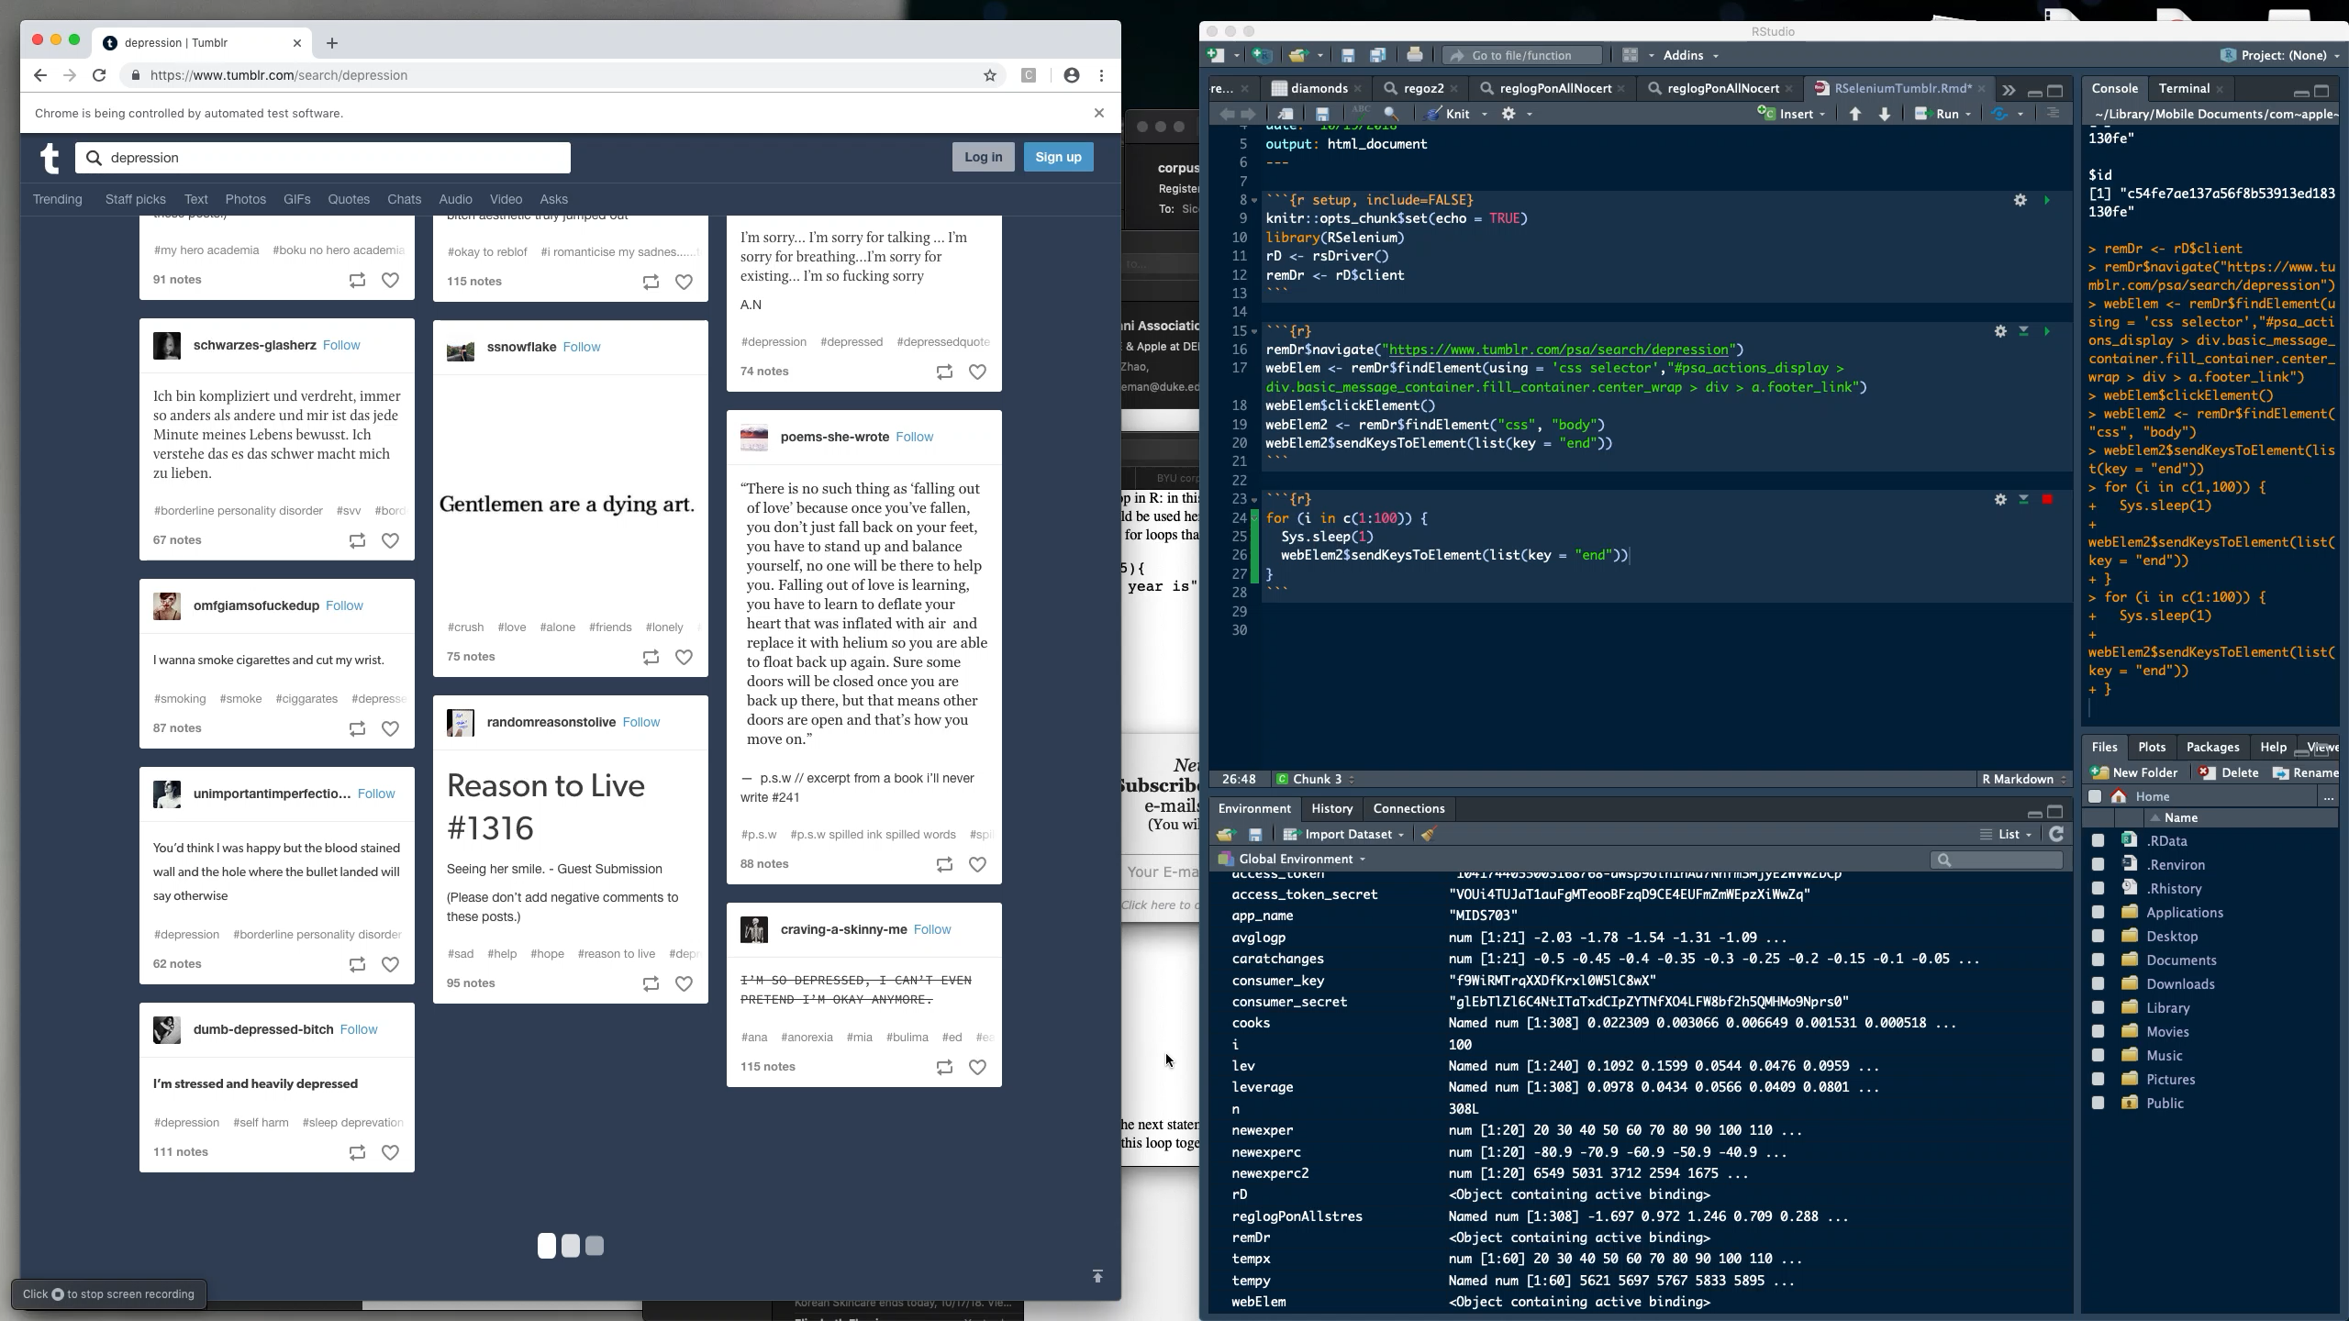
Notes:
Sicong

Slide 7

Ongoing Questions
Time range for data collection? (ex. 1 week, 1 month historical, etc.)
Categories for data collection? (ex. Subreddit vs. search by keyword vs. tagged posts)
Ground truth for our classifier?
Legality of webscraping?
Storage/processing of data?
Emojis ?
Notes:
Allen

